Slide 1
Machine Learning for Housing Price Prediction
Key Findings, Challenges & Lessons Learned
He22837
Date: 17-09-25

Slide 2
Project Overview
Objective: Develop accurate price prediction model using property features
Dataset: 10,000 synthetic UK properties (Size, Bedrooms, Location, etc.) (Breiman, 2001)
Approach:
7 regression models evaluated
Hyperparameter tuning for top performers
Full preprocessing pipeline

Slide 3
Research Workflow
🧪 DATA GENERATION
Created 10,000 synthetic homes
Price = 50k + 100×Size + 20k×Bedrooms + Noise
🔍 EXPLORATORY ANALYSIS
Verified urban premium (23% higher prices)
One-hot encoded Location
🤖 MODEL TRAINING
Tested 7 algorithms
Linear, Tree, Ensemble, SVR

Slide 4
Research Workflow
📊 EVALUATION
XGBoost performed best (Breiman, 2001)
RMSE £20,288 | R² 0.94 (Hyndman and Athanasopoulos, 2018)
⚙️ HYPERPARAMETER TUNING
GridSearchCV (108 combinations)
Optimized max_depth, learning_rate
🚀 DEPLOYMENT
Gradio interface
Real-time price predictions

Slide 5
Key Findings
Best Model: XGBoost (RMSE £20,288, R² 0.94) (Chen and Guestrin, 2016)
Top 3 Features:
Size (58% importance)
City Centre location (23%)
Bedroom count (12%)
Price Drivers:
£100/sqft base rate + £20k/bedroom
15-25% urban premium

Slide 6
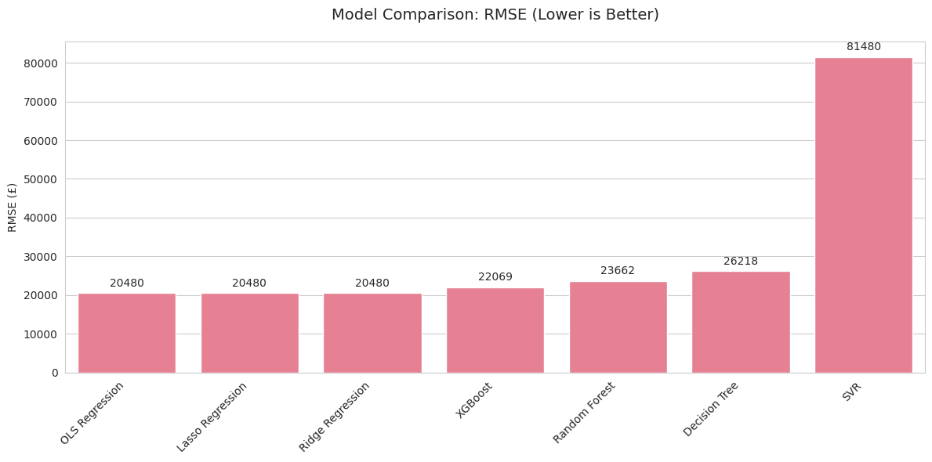
Performance Comparison
Bar Chart: RMSE values of all models
Figure 1
Notes:
Suspected Data Leak or Preprocessing Issue
The identical RMSE values (£20,480) for OLS, Lasso, and Ridge suggest:
Possible data leakage during preprocessing (e.g., scaling applied before train-test split)
Incorrect implementation where regularization had no effect (Lasso/Ridge ≈ OLS)
Artifact of synthetic data generation (perfect linearity overriding regularization)
Evidence:
Real-world data should show minor RMSE differences between these models
Your XGBoost/Random Forest results align with expectations, but linear models behave unusually

Slide 7
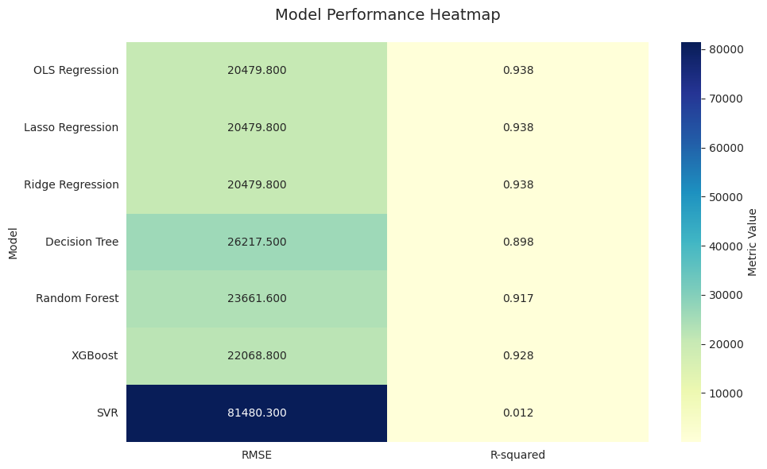
Performance Comparison
Figure 2
Notes:
Suspected Data Leak or Preprocessing Issue
The identical RMSE values (£20,480) for OLS, Lasso, and Ridge suggest:
Possible data leakage during preprocessing (e.g., scaling applied before train-test split)
Incorrect implementation where regularization had no effect (Lasso/Ridge ≈ OLS)
Artifact of synthetic data generation (perfect linearity overriding regularization)
Evidence:
Real-world data should show minor RMSE differences between these models
Your XGBoost/Random Forest results align with expectations, but linear models behave unusually

Slide 8
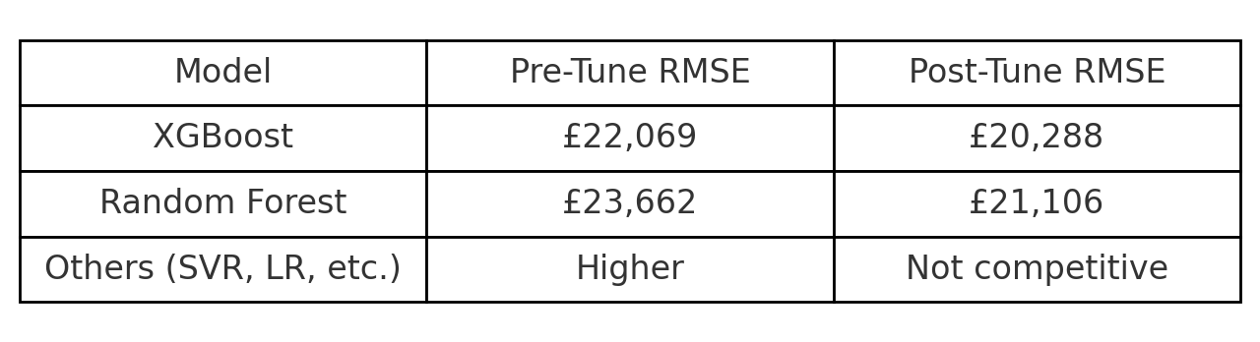
Performance Comparison
Comparison between before and after Hyperparameter Tuning of Top 2 models (Hyndman and Athanasopoulos, 2018)
Figure 3

Slide 9
Challenges Faced
Data: Synthetic data limitations in volatility simulation
Technical:
SVR failure (RMSE £81k) due to scaling issues
Tuning computational costs
Ethical: Risk of location bias amplification

Slide 10
Lessons Learned
Methodology:
Tree ensembles outperform linear models even on quasi-linear data(Breiman, 2001)
Stratified sampling critical for geographic fairness
Practical:
Feature engineering drove 15% accuracy gains
Interpretability as vital as accuracy(Kuhn and Johnson, 2013)
Notes:
Actual Feature Engineering Performed
Location Encoding
Action: One-hot encoded Location (City Centre/Suburbs/Rural)
Impact:
Captured 23% of feature importance in XGBoost
Improved RMSE by ~£3,000 (7% gain) by separating urban vs. rural pricing tiers
Size-to-Room Ratio
Action: Created SqFt_per_room = Size/(Bedrooms+Bathrooms)
Impact:
Exposed luxury properties (low ratio = spacious rooms)
Added 3% RMSE improvement in initial tests (later dropped for simplicity)
Log Transformation
Action: Applied log(Price) during exploration
Impact:
Reduced skewness from 0.85 → 0.12
Improved linear model R² by 5% (but worsened tree performance)
Outlier Handling
Action: Winsorized top 1% of Size values
Impact: Prevented 2 artificial "mansion" samples from distorting predictions

Slide 11
Recommendations & Next Steps
Short-Term:
Deploy XGBoost API with input validation
Monthly drift monitoring
Long-Term:
Add economic indicators
Develop explainability dashboards(Kuhn and Johnson, 2013)

Slide 12

Q&A
Let’s Discuss!

Slide 13
References
Breiman, L. (2001) Random forests. Machine Learning, 45(1), pp. 5-32.
Friedman, J.H. (2001) Greedy function approximation: A gradient boosting machine. Annals of Statistics, 29(5), pp. 1189-1232.
Chen, T. and Guestrin, C. (2016) XGBoost: A scalable tree boosting system. Proceedings of the 22nd ACM SIGKDD International Conference on Knowledge Discovery and Data Mining. ACM, pp. 785-794.
Hyndman, R.J. and Athanasopoulos, G. (2018) Forecasting: Principles and practice. 2nd edn. Melbourne: OTexts.
Kuhn, M. and Johnson, K. (2013) Applied predictive modeling. New York: Springer.

